Slide 1
Excercise 2
Vincent Deuschle, Lorenzo Toso, Natalia Schendzielorz

Slide 2
Data

Slide 3
Difficult Data

Slide 4
General procedure
Parse all records
Using Apache Commons
Translate CSVRecords into a custom Record-Type
Clean all records
Export all records
By using a custom iterator

Slide 5
Cleaning a record
Clean zip-code (remember all additional info that is saved in the ZIP-field)
Clean state
Clean SSN
Use zip to lookup city & state
Use city, state and address to lookup zip
If some values were not found:
Use data found in zip-code
Default values
Clean Non-Numeric values

Slide 6
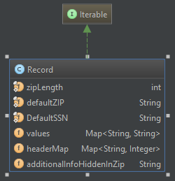
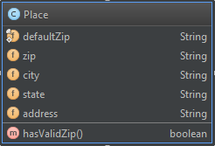
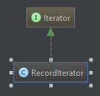
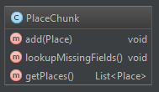
Class hierarchy

Slide 7
Problem: Wrong Results
Wrong state abbreviations
If no valid state is provided and no valid zip code is found the first two letters of the data are used
Cali -> CA
California -> CA
Maryland -> MA
MD would be correct
Could be fixed with a new lookup

Slide 8
Problem: Performance
Due to the API being very slow:
Chunk place lookups into chunks of size 5 (maximum allowed by API)
Class „PlaceChunk“
Changes program structure to always clean 5 records at a time

Slide 9
Results:
Detection precision: 0.8949
Detection recall: 0.9347

Slide 10
Libraries
Apache Commons
CSV parsing
StringUtils
Jsoup
Handling Web requests
Result parsing

